Slide 1














AI TraceFinder
Ann Flo S Poonolil
College Of Engineering Trivandrum

Slide 2

Problem Statement
Scanned documents contain device-specific noise and artifact patterns unique to each scanner.
Identifying the source scanner of a document is challenging using manual inspection alone.
This project aims to automatically classify the scanner brand/model using machine learning and deep learning techniques.

Slide 3
Digital Forensics: Identify the scanner used in forged or tampered documents during investigations
01.
Use Cases:
Document Authentication:Verify whether scanned documents originate from authorized scanner devices.
02.
Legal Evidence Verification: Ensure scanned documents submitted in legal proceedings come from approved sources.
03.

Slide 4
Dataset:
Processing & Engineering:
Data Collection:
Dataset Statistics:
Created a specialized collection of flat-field images, original document scans, and Wikipedia-sourced materials to capture diverse sensor-level data.
Structured a robust dataset across various classes, utilizing an 80/10 split to ensure the model generalizes effectively across different document types.
Focused on isolating PRNU (sensor fingerprints) from flat-field and scanned images to distinguish unique hardware traits from document content.

Slide 5
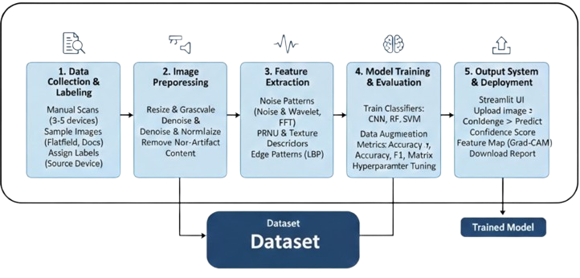
System Architecture

Slide 6
Phases of Development
01
02
03
04
Data Collection And Preprocessing:
Collected a diverse dataset of flat-field images and document scans (Original/Wikipedia) and standardized them through resizing and normalization to prepare for deep learning.
Feature Engineering & Baseline Modeling:
Extracted forensic-specific features like PRNU noise patterns, FFT frequency signals, and LBP textures to establish a performance baseline using traditional ML classifiers.
Deep Learning Model & Explainability:
Developed a CNN architecture to automatically learn complex scanner artifacts and utilized tools like Grad-CAM to visualize which image regions influenced the identification.
Deployment & Final Reporting:ntegrated the trained model into a Streamlit UI, enabling users to upload scans and receive real-time predictions with confidence scores and forensic analysis reports.

Slide 7
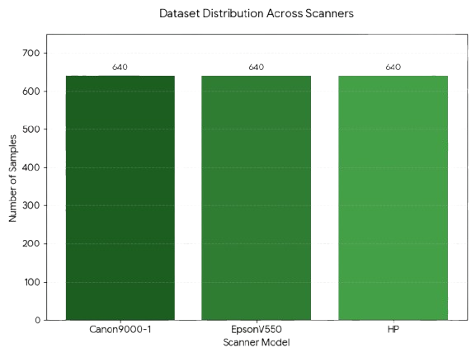
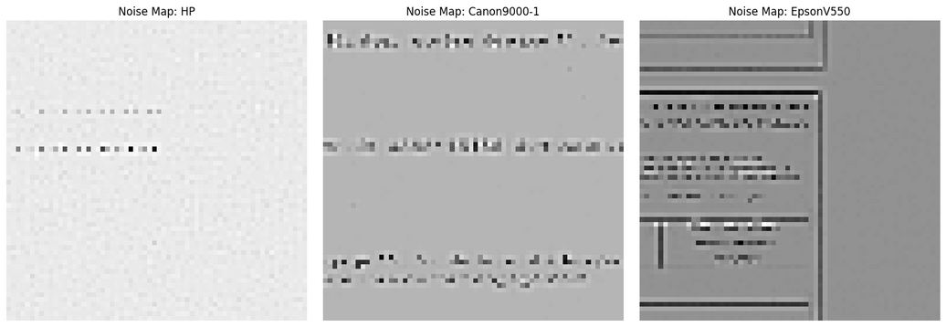
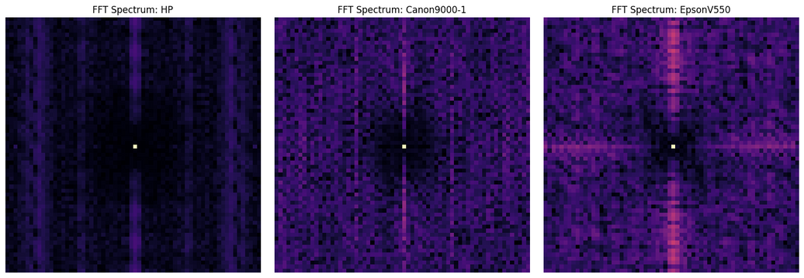
Exploratory Data Analysis (EDA) & Visualization:
Noise map visualisation
FFT Spectrum

Slide 8
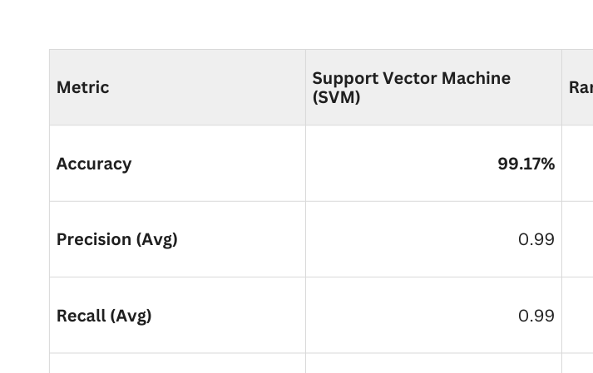
Performance Analysis - Baseline Models
To validate the strength of the extracted sensor features, two traditional machine learning classifiers were tested- SVM and Random Forest. Both models demonstrated exceptional capability in distinguishing between the three scanner classes (Canon, Epson, HP).

Slide 9
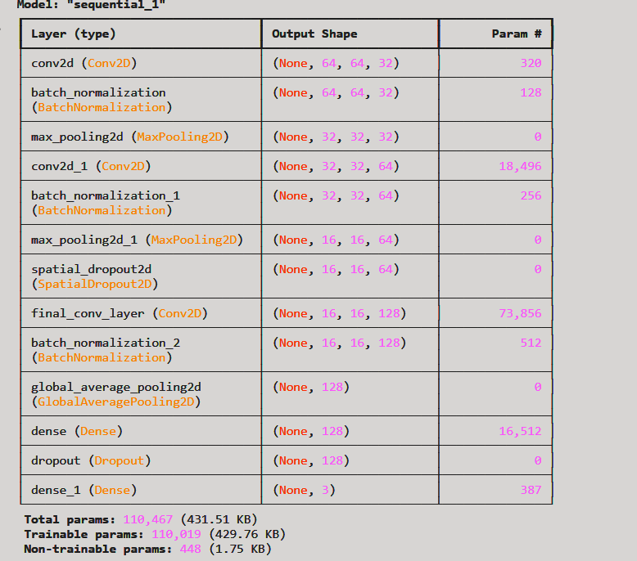
Proposed CNN Architecture
Input: 64 X 64 X 3 image patches.
Layers: Conv2D (32/64/128 filters) + BatchNormalization + Global Average Pooling.
Regularization: SpatialDropout2D and standard Dropout (to prevent overfitting).
Total Parameters: 110,467 (Efficient & Lightweight).

Slide 10
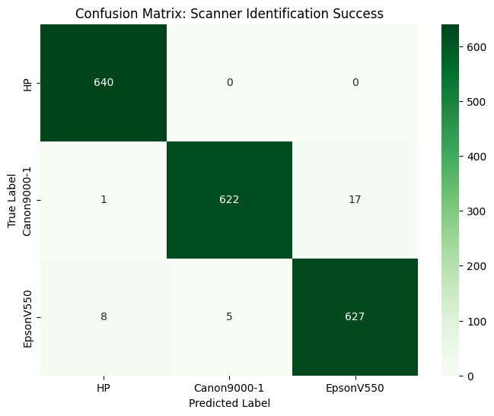
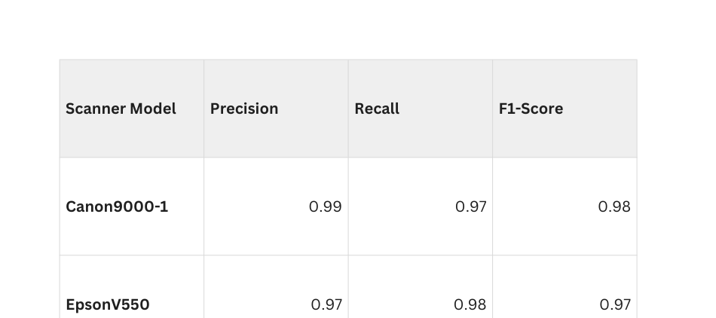
CNN Results:
Performance Summary:
Overall Accuracy: 98.00%
Dataset Size: 1,920 Total Test Samples (Balanced: 640 per class)
Weighted F1-Score: 0.98

Slide 11
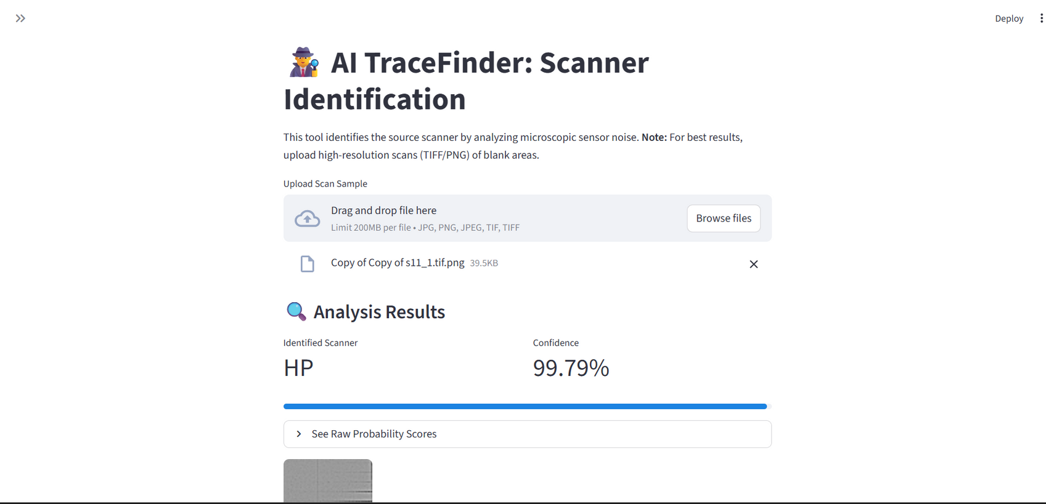
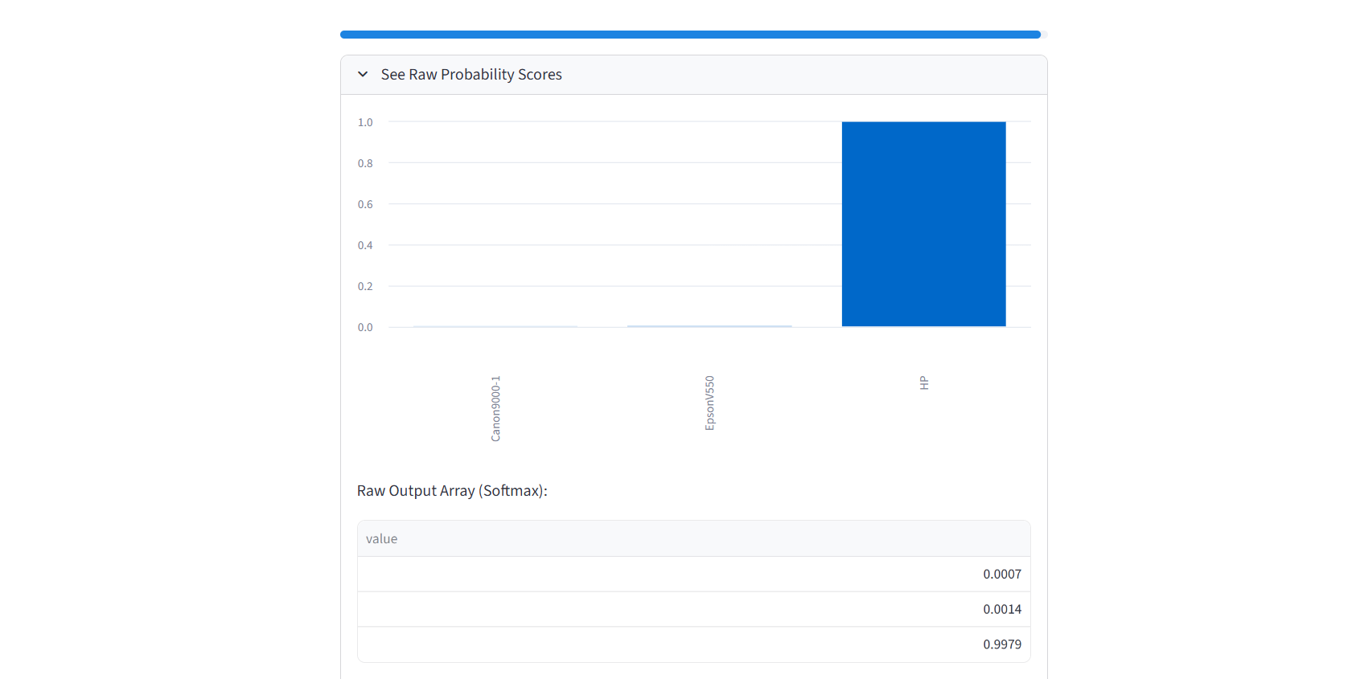
Working:

Slide 12
Conclusion
Successful Attribution: Demonstrated that microscopic sensor fingerprints are unique and identifiable across different scanner hardware with 98-99% accuracy.
Baseline vs. Deep Learning: Traditional ML (SVM) provides a high-accuracy benchmark, while the CNN architecture offers a scalable, automated solution for raw image forensic analysis.
End-to-End Solution: Developed a functional Streamlit application capable of real-time hardware identification for digital forensic investigations.

Slide 13

Future Outlook
Device Expansion: Scale the dataset to include high-end office photocopiers and smartphone camera sensors to address the rise in mobile document scanning.
Document Integrity Mapping: Implement Localized Tamper Detection. If a document contains a signature scanned on a different device than the body of the text, the system could flag the specific region as a mismatch.
AI-Generated Detection: Integrate "Synthetic Trace" detection to distinguish between real physical scans and AI-generated document forgeries.

Slide 14
Thank you !

